Slide 1
The OSI Model

Slide 2

An open systems interconnection (OSI) reference model was developed by the International Organization for Standardization in 1984 to enable different types of networks to be linked together.
The OSI Model

Slide 3
The model contains seven layers, as shown in Fig. 1-6. The seven layers of the OSI reference model describe networking functions from the physical network interface to the software applications interfaces.

Slide 4
The intent of the OSI model is to provide a framework for networking that ensures compatibility in the network hardware and software and to accelerate the development of new networking technologies.

Slide 5
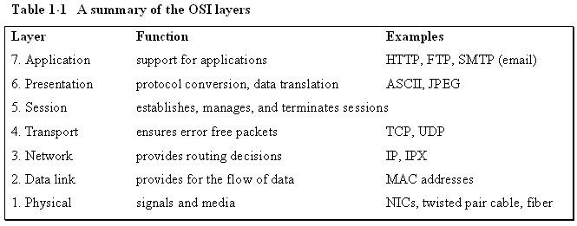
Table 1-1 A summary of the OSI Layers

Slide 6
Physical layer - provides the electrical and mechanical connection to the network. Examples of technologies working in this layer are EIA/TIA related technologies, UTP, fiber, and NICs

Slide 7
Data Link layer - handles error recovery, flow control (synchronization), and sequencing (which terminals are sending and which are receiving). It is considered the "media access control layer" and is where the MAC addressing is defined. The Ethernet 802.3 standard is defined in this area, which is why the MAC address is sometimes called the Ethernet address.

Slide 8
Network layer - accepts outgoing messages and combines messages or segments into packets, adding a header that includes routing information. It acts as the network controller. Examples are IP and IPX

Slide 9
Transport layer - is concerned with message integrity between the source and destination. It also segments/reassembles (the packets) and handles flow control. Examples are TCP and UDP.

Slide 10
Session layer - provides the control functions necessary to establish, manage, and terminate the connections as required to satisfy the user request.

Slide 11
Presentation layer - accepts and structures the messages for the application. It translates the message from one code to another if necessary. This layer is responsible for data compression and encryption.

Slide 12
Application layer - application programs such as word processing, spreadsheets, and email log the message in, interpret the request, and determine what information is needed to support the request.

Slide 13
The Network Administrator and the OSI Model
The network administrator uses the OSI model for troubleshooting network problems by verifying functionality of each layer. In many cases, troubleshooting the network problem requires that the network administrator isolate what layer the network problem occurs.

Slide 14
The Network Administrator and the OSI Model
Assume that a network is having problems accessing an email server (a layer 7 application).
The first troubleshooting step for the network administrator is to ping the IP address of the email server (layer 3 test). A “ping” to an IP address can be used to quickly check that there is a network connection. A “reply from” response for the ping indicates the connection to the server is up. A “request timed out” response indicates there the network connection is down.
This could be due to a cabling problem (layer 1) or a problem with a switch (layer 2), or a router (layer 3), or the server could be completely down (layer 7).

Slide 15
The Network Administrator and the OSI Model
In the case of “request timed out” the network administrator will have to go directly to telecommunications closet or the machine to troubleshoot the problem.
In this case, the network administrator should first check for layer 1 (the physical layer) problems. Many times this just requires that the network administrator verify that a network cable is connected.
Remember the concept of checking for a “link light?” Cables do get knocked loose or break.

Slide 16
The Network Administrator and the OSI Model - summary
The networking administrator needs to have a good understanding of the all seven layers of the OSI model. Knowledge of the layers can help to isolate the network problem. There are three basic steps in the process of isolating the network problem:
Is the connection to the machine down? (layer 1)
Is the network down? (layer 3)
Is a service on a specific machine down? (layer 7)

Slide 17
The Ethernet LAN

Slide 18
Ethernet
The networking protocol used in most modern computer networks is Ethernet.
Ethernet is a CSMA/CD LAN protocol.
CS – Carrier Sense
MA – Multiple Access
CD – Collision Detection

Slide 19
Ethernet Packet
The information in an Ethernet network is exchanged in a packet form.
The packet provides grouping of the information for transmission.

Slide 20
The Ethernet Packet
Preamble – an alternating pattern of 1’s and 0’s used for synchronization

Slide 21
The Ethernet Packet
Start Frame Delimiter – a binary 8-bit sequence of 1 0 1 0 1 0 1 1 that indicates the start of the frame

Slide 22
The Ethernet Packet
Destination MAC Address and Source MAC Address – Each computer has an Ethernet network interface card (NIC) or network adapter that has a unique media access control (MAC) address associated with it.
The MAC address is 6 bytes (12 hex characters) in length.

Slide 23
The Ethernet Packet
Length / Type - an indication of the number of bytes in the data field if this value is less than 1500.
If this number is greater than 1500, it indicates the type of data format, for example IP or IPX.

Slide 24
The Ethernet Packet
This is the data being transferred from the source to the destination and destination to the source.

Slide 25
The Ethernet Packet
This is the data being transferred from the source to the destination and destination to the source.

Slide 26
The Ethernet Packet
This is the data being transferred from the source to the destination and destination to the source.

Slide 27
The Ethernet Packet
A field used to bring the total number of bytes up to the minimum of 46 if the data field is less than 46 bytes.

Slide 28
The Ethernet Packet
A 4-byte CRC (cyclic redundancy check) value used for error detection. The CRC is performed on the characters from the destination MAC address through the Pad fields. If an error is detected, the system retransmits the data.

Slide 29
The Ethernet Packet
A 4-byte CRC (cyclic redundancy check) value used for error detection. The CRC is performed on the characters from the destination MAC address through the Pad fields. If an error is detected, the system retransmits the data.

Slide 30
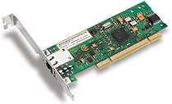
A Network Interface Card

Slide 31
The MAC address
How is the destination and source addresses for the data determined within a LAN?
Networked devices, such as computers and network printers each have an electronic hardware interface to the LAN called a Network Interface Card (NIC) or integrated network port. The NIC contains a unique network address called the MAC address.

Slide 32
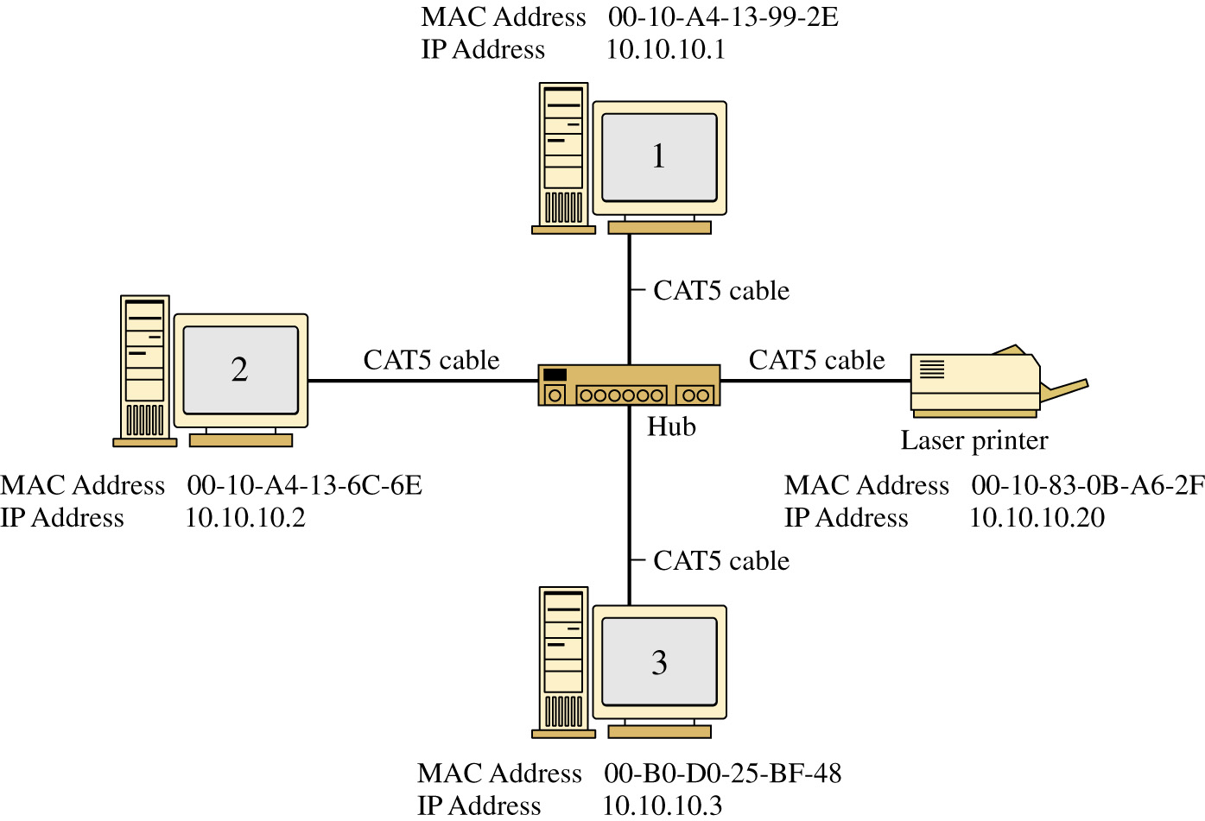
FIGURE 1-26 An example of a small office LAN star topology.

Slide 33
The MAC address
The MAC address is 6 bytes (48 bits) in length.
The address is displayed in 12 hexadecimal codes. The first 6 hexadecimal codes are used to indicate the vendor of the network interface, also called the Organizationally Unique Identifier (OUI)
the last 6 hexadecimal values are unique numbers assigned by the vendor.
IEEE is the worldwide source of registered OUIs.

Slide 34
The MAC address
Table 1-4 A Sample of MAC Addresses
Company ID / Vendor Manufacturer
Serial #
00-AA-00-B6-7A-57 Intel Corporation (00-AA-00)
00-50-73-6C-32-11 Cisco Systems, Inc. (00-50-73)
00-0A-27-B7-3E-F8 Apple Computer Inc. (00-0A-27)

Slide 35
the MAC address
The MAC address, also called the Ethernet, physical, hardware or adapter address
The MAC address can be obtained from computers operating under Microsoft Windows by typing the ipconfig /all command while in the command mode.

Slide 36
ipconfig /all demonstration
Click on Start – Run and enter the
command cmd
Enter ipconfig /all to display the MAC address

Slide 37
IP Addressing
The MAC address provides the physical address for the network interface card, but provides no information as to its network location or even on what LAN, or in which building, city, or even the country in which the network resides?
IP addressing provides a solution to worldwide addressing.

Slide 38
IPv4 Addressing
The IP address is a unique 32 bit address that identifies on which network the computer is located. The address is divided into four 8-bit parts. The format for the IP address is
A . B . C. D.
where the A.B.C.D. values are written as the decimal equivalent of the 8-bit binary value. The range for each of the decimal values is 0 to 255.

Slide 39
IPv4 Addresses
IP addresses are issued based upon the class of the network. Examples of the classes of IP networks are provided in Table 1-4 of the text.
Class Description Example IP Numbers
Class A Governments, very large networks 44.* .*.*
Class B Midsize companies, universities, etc. 128.123.".*
Class C Small networks 192.168.1.*

Slide 40
IPv4 Addressing
Table 1-6 The Address Range for each Class of Network
Class A 0.0.0.0 to 126.255.255.255
Class B 128.0.0.0 to 191.255.255.255
Class C 192.0.0.0 to 223.255.255.255

Slide 41
IPv4 Addressing
network number is the portion of the IP address that defines which network the IP packet is originating from or being delivered to.
The * entries for each class represent the host number. The host number is the portion of the IP address that defines the address of the networking device connected to the network. The host number is also called the host address.
10.10.20.200
172.16.25.191
192.168.12.5
Notes:
<number>

Slide 42
IPv4 Addressing
The network number provides sufficient information for routing the data to the appropriate destination network.
The destination network then uses the remaining information (the * portion) to direct the packet to the destination computer or host.
The * portion of the address is typically assigned by the local network system administrator or is dynamically assigned when users need access outside their local networks.
10.10.20.200
172.16.25.191
192.168.12.5

Slide 43
IPv4 Addressing - ISP
your Internet Service Provider (ISP) dynamically assigns an IP address to your computer when you log on to the Internet.
Remember, you can check the IP address assigned to your computer by your ISP using the ipconfig command in the command prompt.
10.10.20.200
172.16.25.191
192.168.12.5

Slide 44
IPv4 Private Addresses
Private IP Addresses
10.0.0.0 - 10.255.255.255
172.16.0.0 - 172.31.255.255
192.168.0.0 - 192.168.255.255

Slide 45
Private IP Addresses
Private addresses are IP addresses set aside for use in private intranets.
An intranet is an internal network that provides file and resource sharing.
Private addresses are not valid addresses for Internet use because they have been reserved but can be used within a private LAN to create an IP network.

Slide 46
IP Network
An IP network is one that uses IP addressing for identifying devices connected to the network and is also the addressing scheme used in TCP/IP networks.
TCP/IP stands for Transmission Control Protocol/Internet Protocol and is the protocol suite used for internetworks such as the Internet.
The topic of IP addressing will be examined in greater detail throughout the text. For Chapter 1 the objective is to use the IP addresses for configuring the address of the computers for operation in a TCP/IP network.

